Slide 1
Retail Sales & Customer Behavior Analysis
Presented by
TỪ VINH QUÝ
March
2026

Slide 2
Dataset Overview
Source
Sports Footwear Sales & Consumer Behavior - Kaggle
https://www.kaggle.com/datasets/aliiihussain/sports-footwear-sales-and-consumer-behavior
Description
This dataset contains realistic sales, pricing, and consumer data for sports footwear from 2018 to 2026. It covers multiple global brands (Nike, Adidas, Puma, Reebok, ASICS, New Balance) and consists of 30000 rows.
Purpose and Outcome
Purpose: Analyze customer ‘s favourite brands, customers behaviors and optimal discount range to maximize revenue.
Outcome:
Provide insights to have company increase revenue through better pricing strategies and enhance customer satisfaction.
March
2026

Slide 3
Dataset Structure
Order details:
order_id
order_date
Sales metrics:
Units_sold
Revenue_usd
Product info:
brand
Model_name
Category
Size
Color
Gender
Customer info:
Country
Customer_income_level
Customer_rating
Channel & payment:
Sales_channel
Payment_method
Pricing:
Base_price_usd,
Discount_percent,
Final_price_usd
March
2026

Slide 4

Data cleaning
Check missing values
Convert date to datetime format
Create additional columns( month, discount_bucket)
2. EDA
Descriptive statistics
Correlation analysis
Trend analysis over time
3. Analysis and give insights
Key analytical questions:
How does revenue vary across different countries?
How do discounts impact units sold and total revenue?
What is the optimal discount range that maximizes revenue?
Which customer income level contributes the most to total revenue?
Data Analysis Process
March
2026

Slide 5
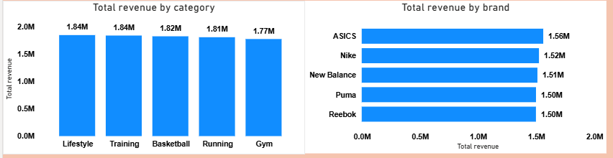
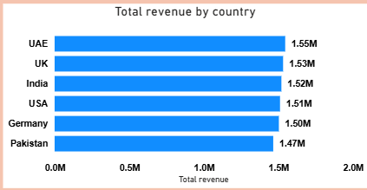
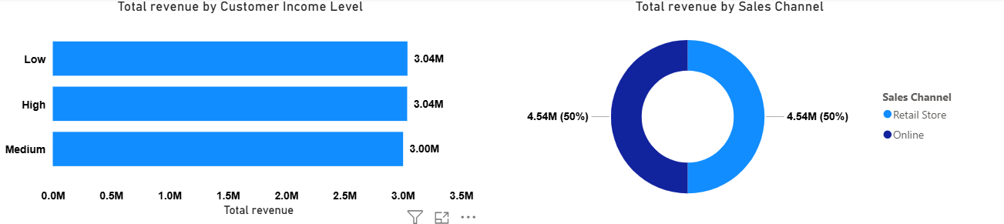
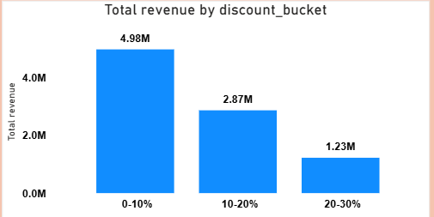
-> Overall, the company’s revenue is relatively consistent, with no significant differences across countries, income levels, or between the two sales channels.
Key Findings
March
2026

Slide 6
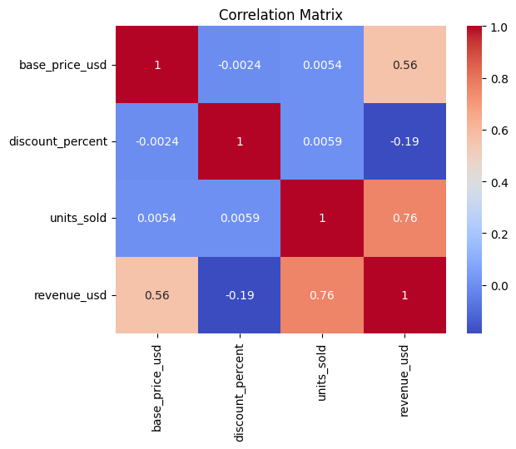
1 Revenue = 0.76 units sold -> Company depends more quantity-driven than price-driven
=> Focus on increasing sales volume (marketing, advertising)
1 Revenue = 0.56 Price -> Price is not the dominant factor to increase revenue
1 discount = - 0.19 Revenue -> Discounts do not boost revenue
=> Not effective
1 discount - 0.005 Units sold -> Discounts have almost no effect on sales volume
=> Not effective
Key Findings
March
2026

Slide 7
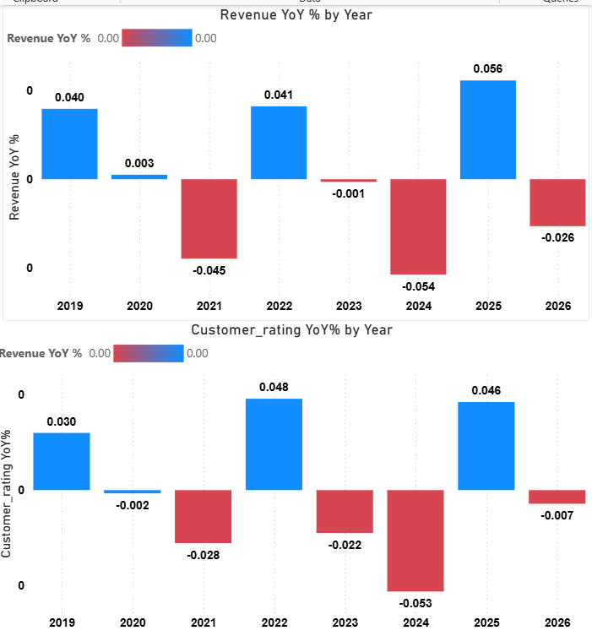
When rating increase → revenue ↑ (2019, 2022, 2025)
When rating decrease → revenue ↓ (2021, 2023, 2024, 2026)
-> Revenue growth closely follows customer satisfaction trends.
=> Company should increase customer satisfactions as it affect directly to company’s revenue and profitability.
Key Findings
March
2026

Slide 8
Focus on Pricing & Promotions to improve sales.
Focus on increasing customer satisfaction to gain revenue.
Using promotions for targeted products instead of discounts for everything
Business Recommendations
March
2026

